Slide 1


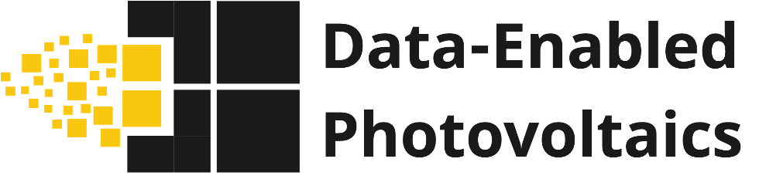
Data Frameworks and Infrastructure RDF
Brent Thompson
¹Florida Solar Energy Center, UCF
²Materials Science and Engineering, College of Engineering and Computer Science, UCF
³RISES Cluster, Faculty Cluster Initiative, UCF
Notes:
Delete and add logos as needed

Slide 2
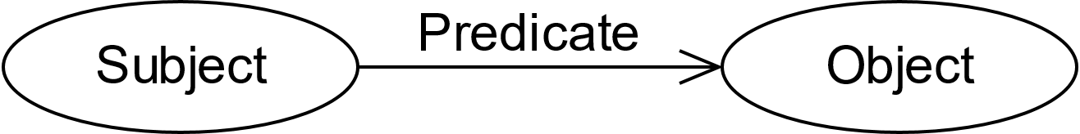
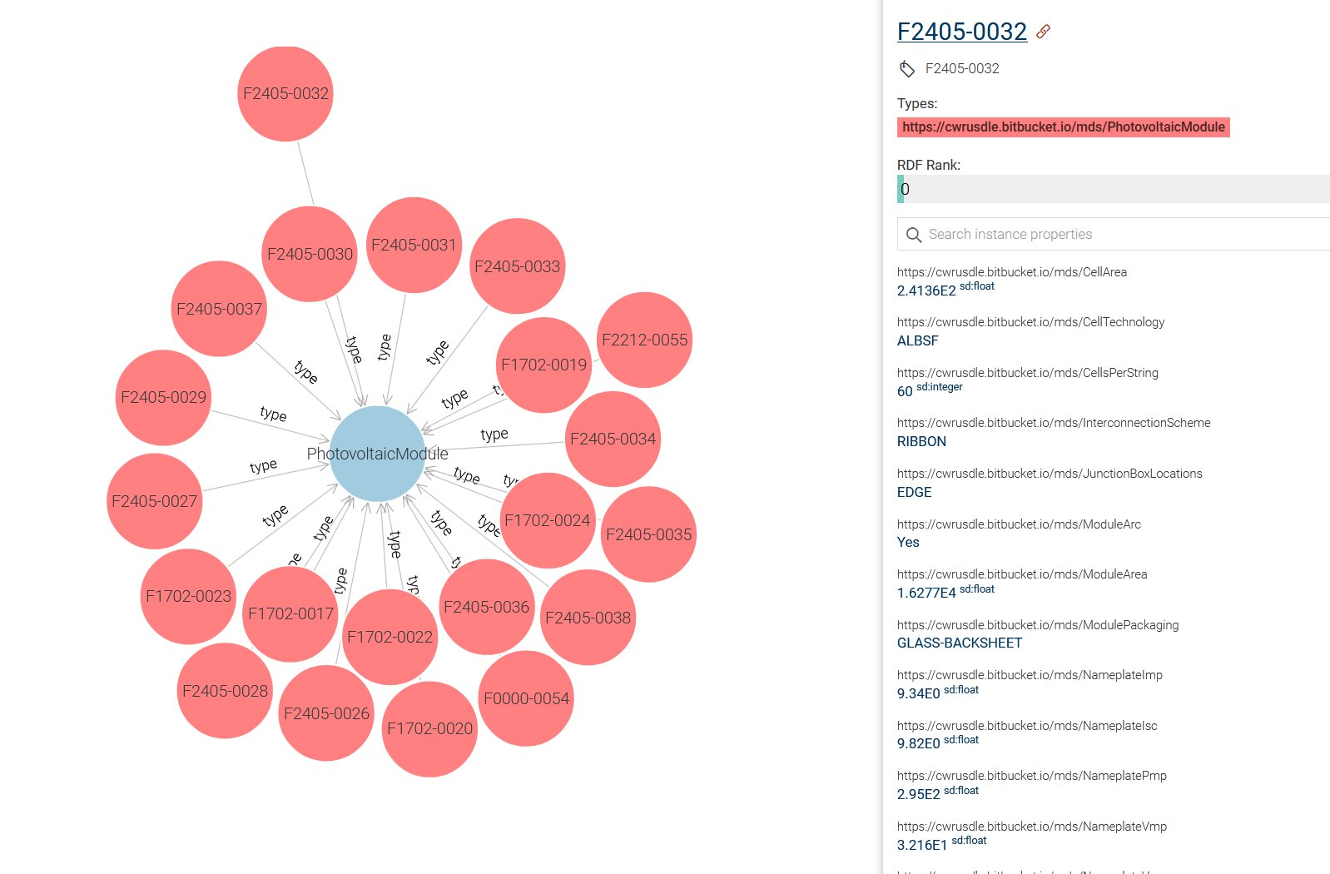
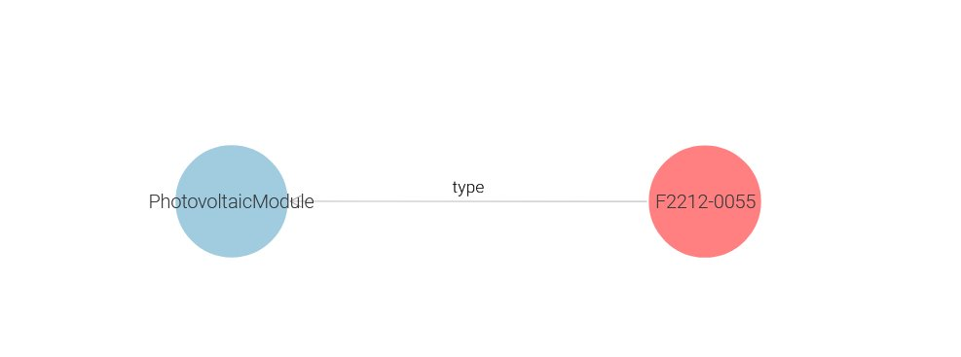
Resource Description Framework
An RDF graph has two nodes (Subject and Object); with a triple connecting them (Predicate)
RDF 1.1 Concepts and Abstract Syntax

Slide 3
Shape Expressions (ShEx)

Slide 4
Describing RDF Graph Structures with ShEx
ShEx focuses on describing the structure of RDF, and what pattern the data should follow.
Not a W3C standard but is widely used and has been adapted into other standards.
RDF ShEx is nearly synonymous with Table Schema from SQL. Slightly more complex syntax, yet functionally the same.
Additional context is provided through prefixes and relationships as properties of a 'shape'.
Used to validate TTL files by ensuring the data abides by a schema.

Slide 5
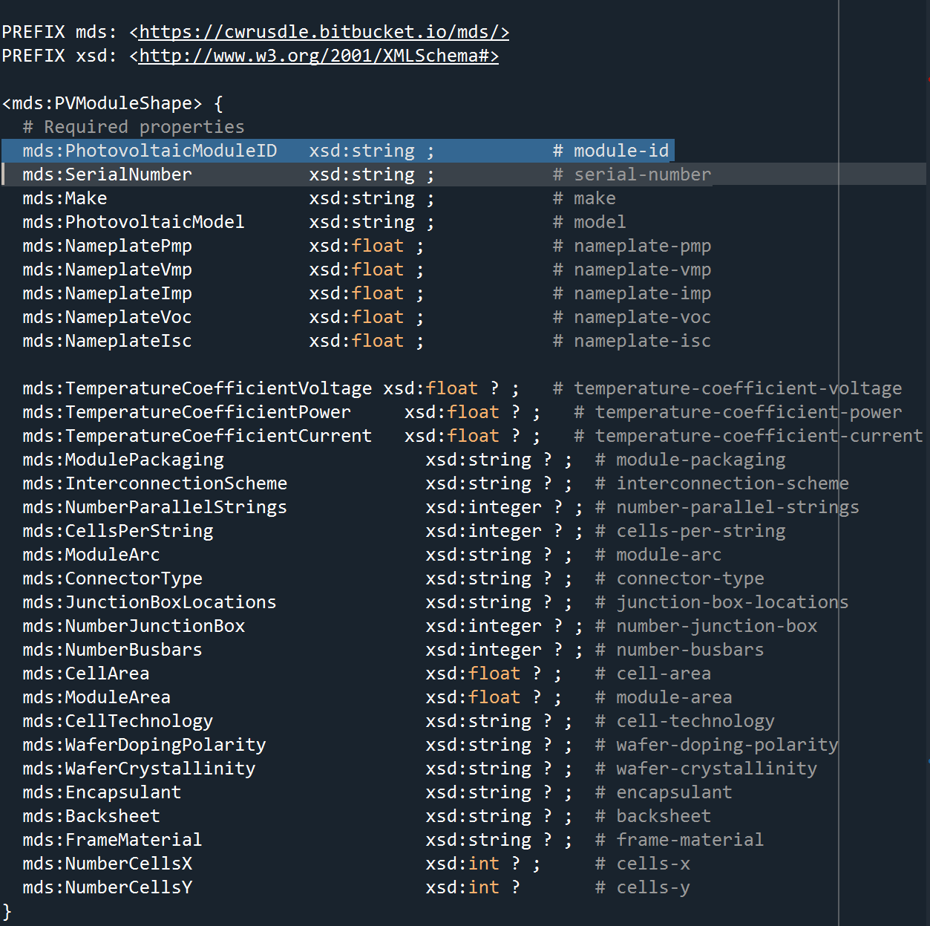
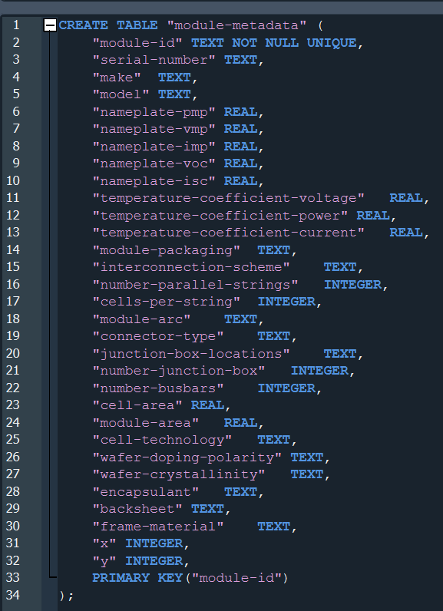
ShEx Schema from SQL schema
One to one mapping from SQL column names to ShEx shape property.
Datatypes in SQL translate to datatypes in ShEx.
Normalizing tables into SQLite directly supports creation of new RDF triples.
FSEC tables represent domains and datasets, containing real data.
SQLite Module Metadata Schema
ShEx Module Metadata Schema

Slide 6
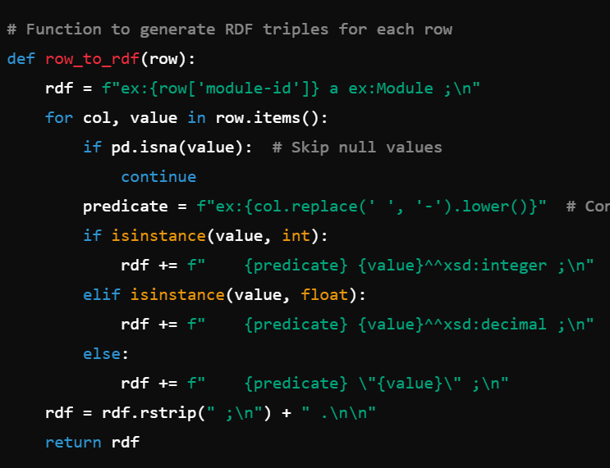
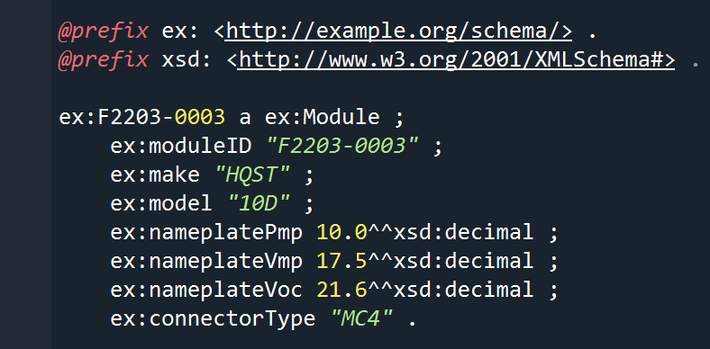
Using ShEx to create TTL
Proper MDS3 ontologies and connections need to be added as predicates to map terms correctly.
Programmatic approaches allow reproducibility and flexibility throughout development.
Translate relational data into Terse RDF triples.
Terse RDF Triple Language (Turtle) example

Slide 7
Shapes Constraint Language (SHACL)

Slide 8
Describing RDF Graph Structures with SHACL
W3C Standard RDF Validation Language
SHACL focuses on defining constraints on data and enforcing business logic
Constraints are enforced verbosely, providing error checking on the data.
Main difference from ShEx is that SHACL can enforce business logic and catch bad data.
Shapes – Structure of the data as it is defined in SHACL. Define properties, nodes, relationships. Expressed in triples with predicate sh:shape.
Constraints – Conditions that the data must meet to be valid. Property constraints apply to specific nodes in the graph. Represented by predicate sh:constraint
Target – Specifies the node that a constraint applies to. Expressed as either a filter or a node type. Expressed in triples with the predicate sh:target

Slide 9
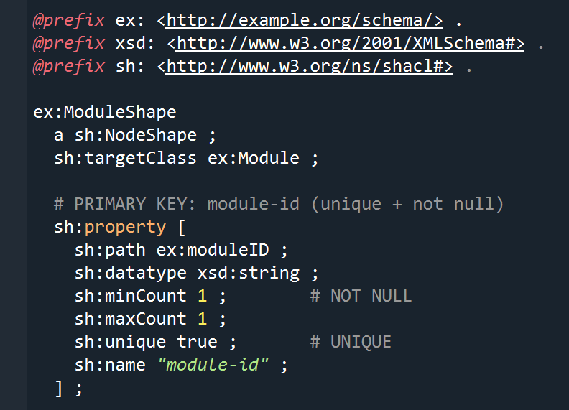
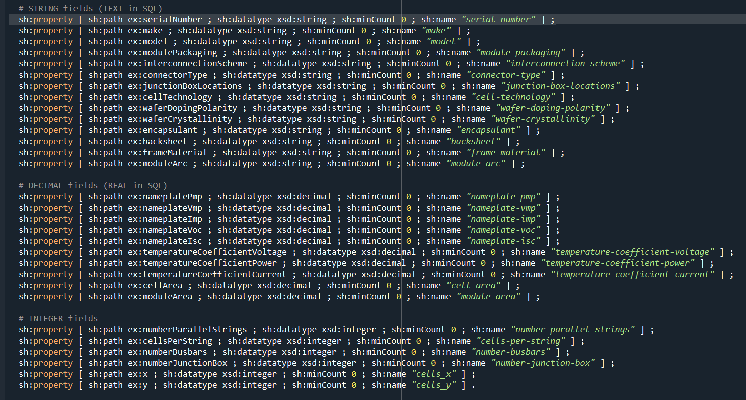
SQL Schema to SHACL Schema
Both images together represent a single SHACL TTL file.
Next steps require connecting MDS3 Ontology files to our real data.
SHACL Module Metadata Schema

Slide 10
SPARQL Protocol & RDF Query Language
Query Specification | SQL | SPARQL
Advantages | Long term relational data query standard, fast returns, low technical overhead, ACID compliance, day to day toolkit. | Current standard for graph database queries, leverages RDF to enrich data providing context for ML/AI, interoperability
Use cases | Raw data table joins, data cleaning and preprocessing. Local data manipulation, sharing raw data | Complex joins or sematic reasoning on data, knowledge graphs and visualizations, EDA. Unstructured data
Disadvantages | Limited to tables, complex joins become exponentially more complicated | Requires ontologies, defined terms, and ttl files.
Syntax | SELECT <attribute list> FROM <table list> WHERE <test expression> | SELECT <variable list> WHERE {<graph pattern> }

Slide 11
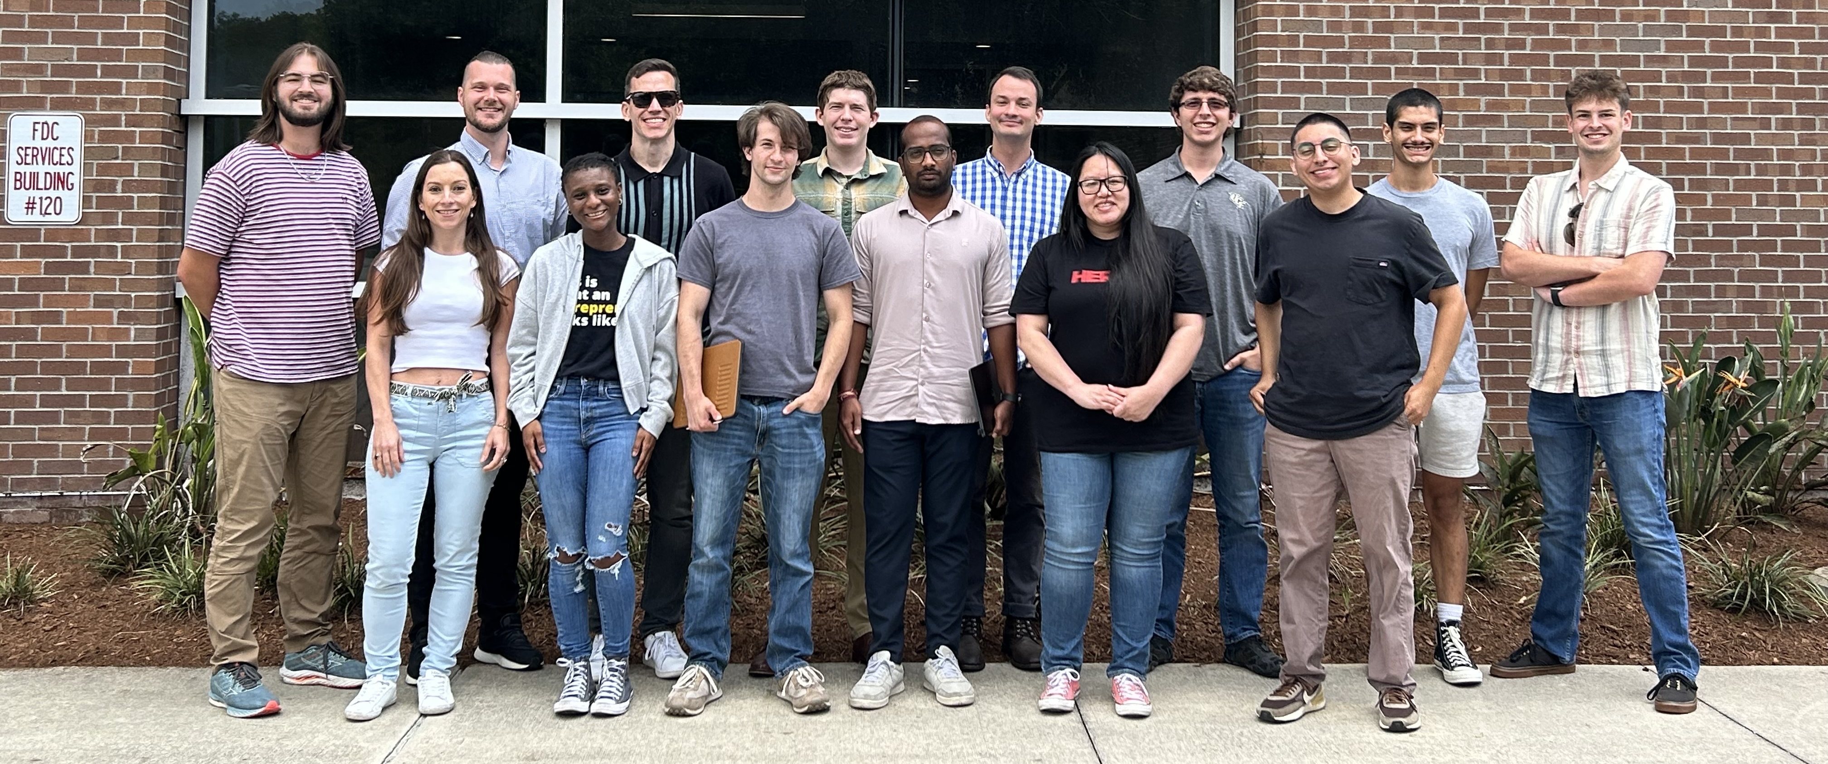
Thank you! Any questions?
UCF Data-Enabled Photovoltaics Team
Notes:
Multiscale DE-EE0009347
CARES DE-EE0010418
Copper Metallization DE-EE0010494
Accelerated Screening (SIPS) DE-EE0010250

